Slide 1



TCC GROUP
YOUR BUSINESS ACCELERATOR

Slide 2



TCC GROUP
YOUR BUSINESS ACCELERATOR
SM﻿E Accelerator Program
SME
A SME accelerator program is designed to offer a holistic approach to business development, emphasizing rapid growth, scalability, and sustainability for the participating small and medium-sized enterprises.
Aim to designed to provide guidance, support, and practical advice to small and medium-sized businesses to help these businesses to overcome challenges, improve their operations, and achieve sustainable growth.
CLINIC
CONFIDENTIAL AND PROPRIETARY
ANY USE OF THIS MATERIAL WITHOUT SPECIFIC PERMISSION IS STRICTLY PROHIBITED

Slide 3










TCC GROUP
YOUR BUSINESS ACCELERATOR
Corporate Governance & Compliance
Key
Challenges:
Accounting Practices
Addressing these challenges requires strategic planning, resource allocation, and adaptability.
SME clinics provide tailored support through workshops & mentorship to enhance competitiveness and resilience.
Financial Strategy
Fund Raising
CONFIDENTIAL AND PROPRIETARY
ANY USE OF THIS MATERIAL WITHOUT SPECIFIC PERMISSION IS STRICTLY PROHIBITED

Slide 4
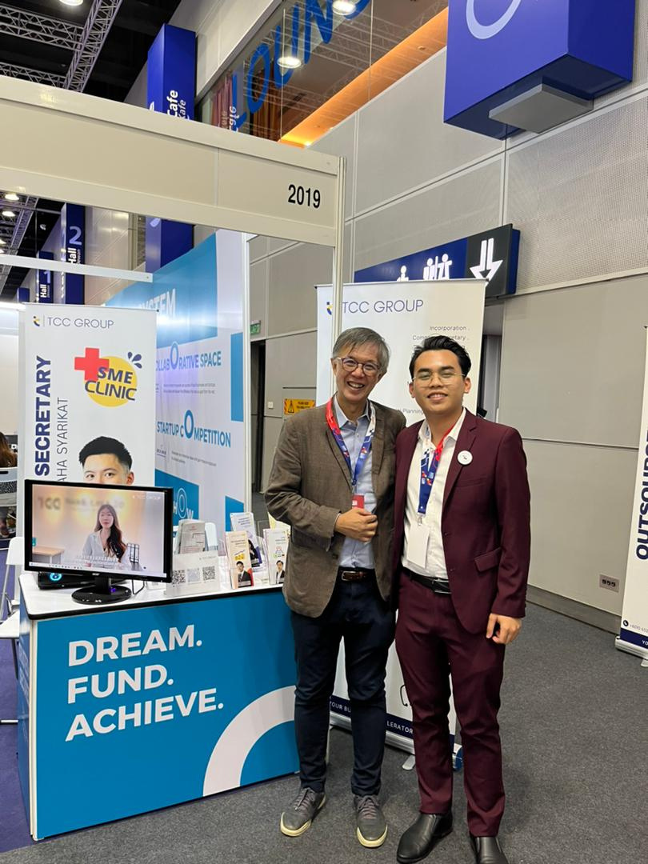
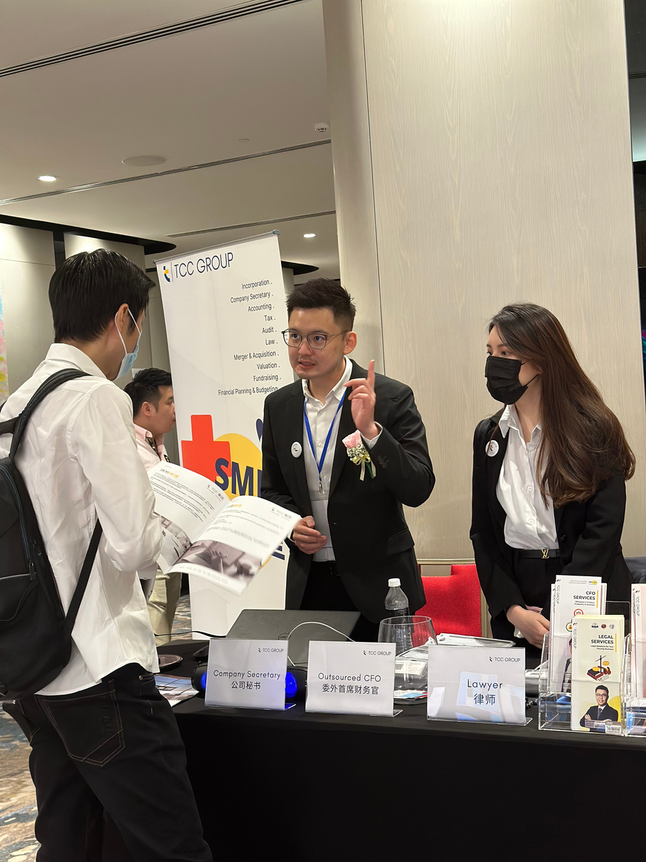
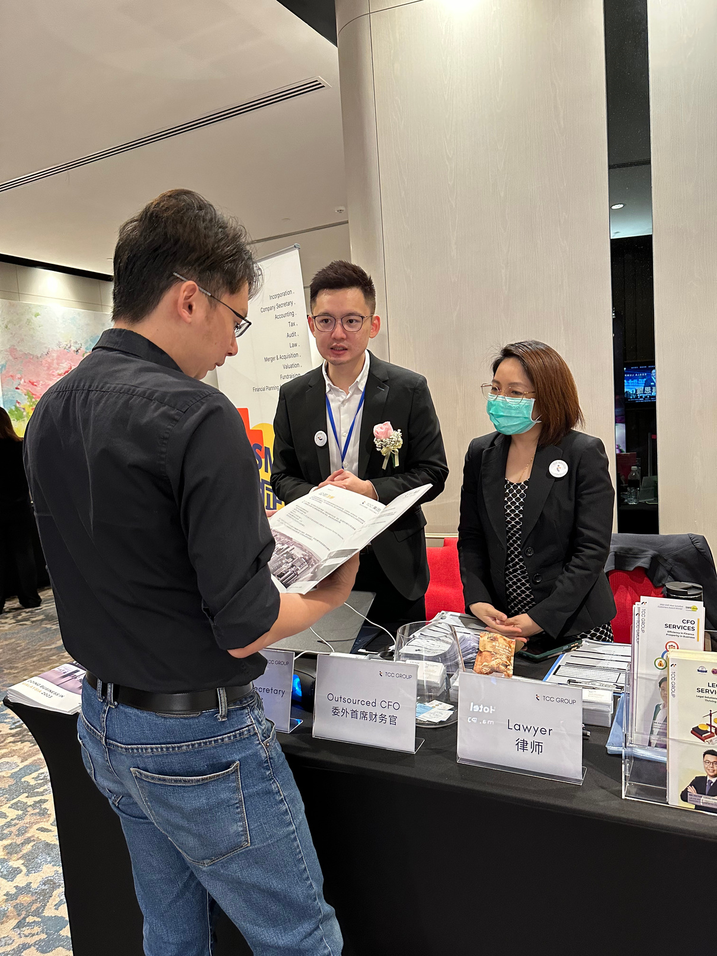
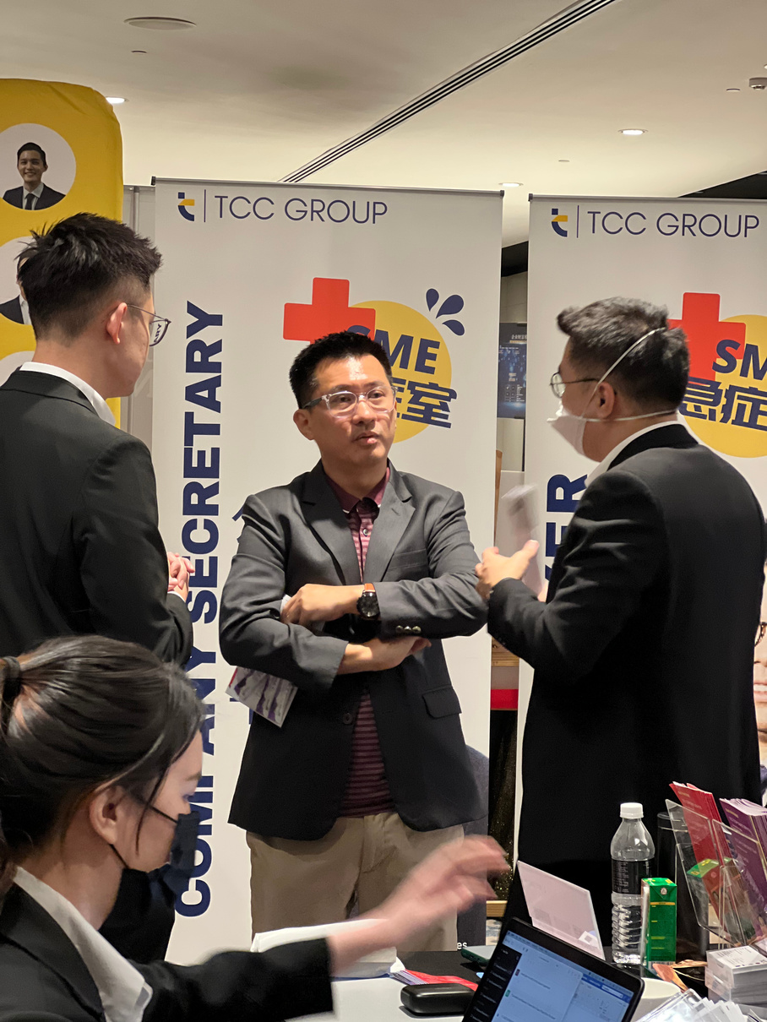
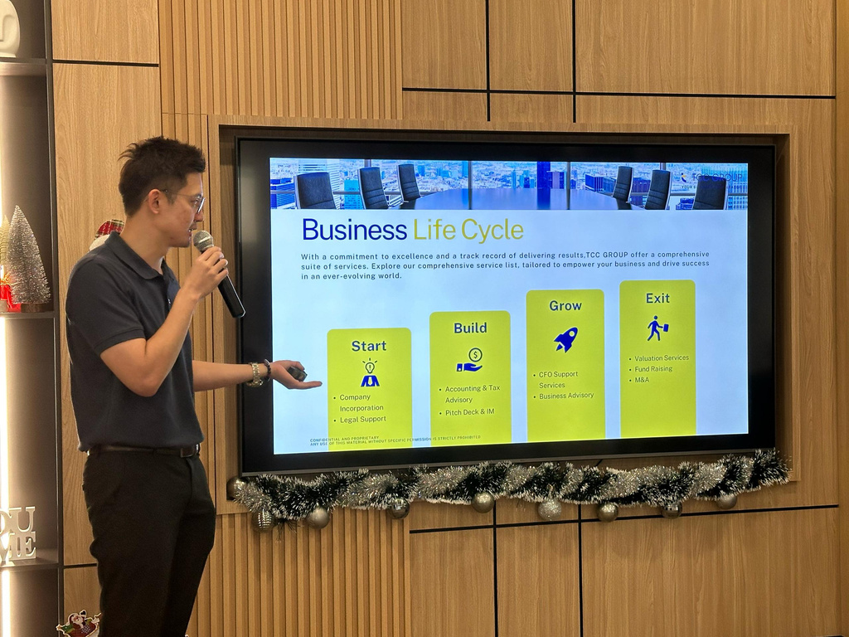
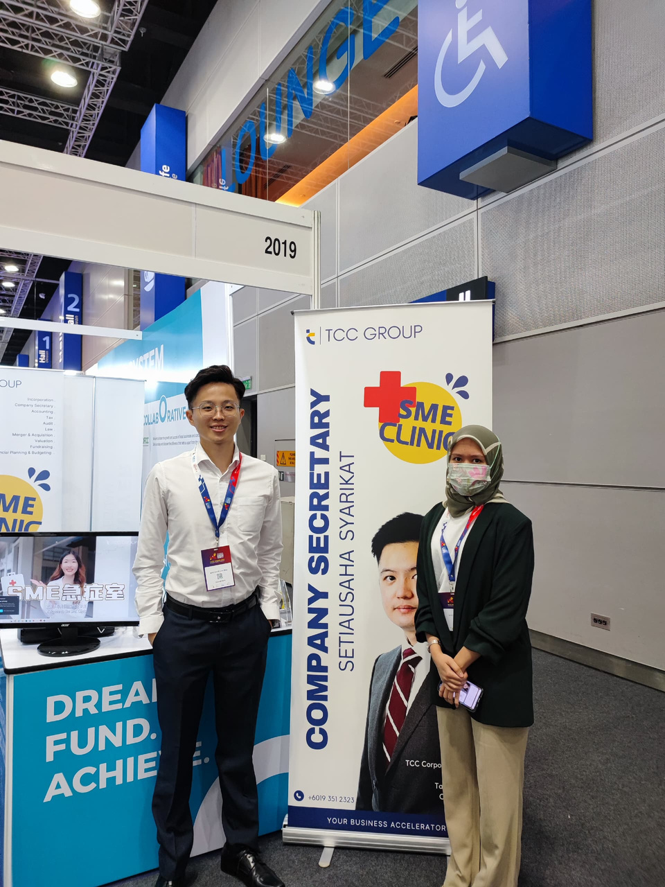
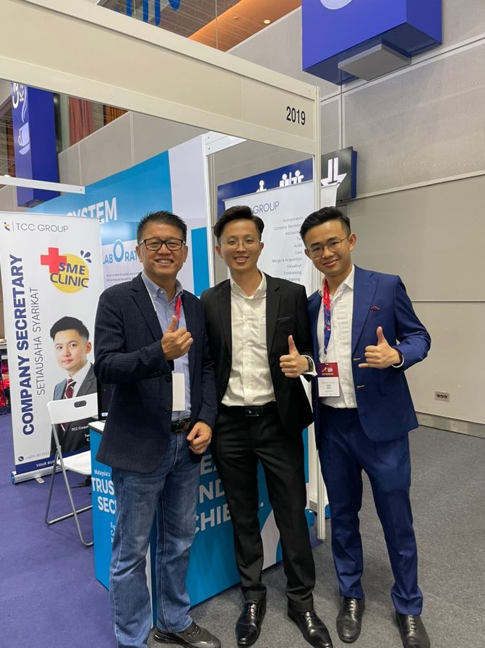

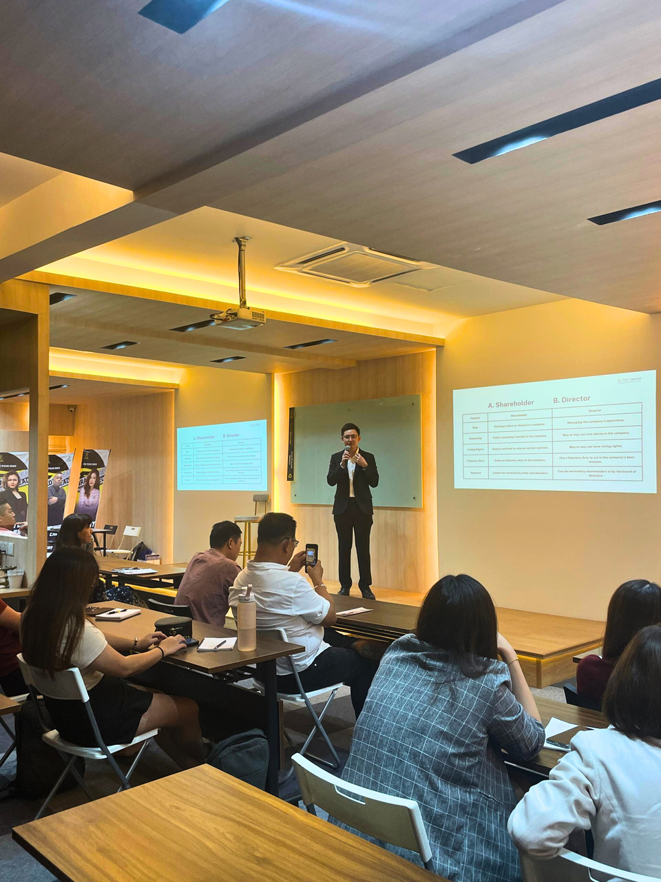
TCC GROUP
YOUR BUSINESS ACCELERATOR
SME
CLINIC
SM﻿E Accelerator Program
Navigating | Supporting | Succeeding

